Slide 1
Catalyst optimizer
Most of the power of Spark SQL comes due to Catalyst optimizer, so it makes sense to spend some time understanding it.
Catalyst optimizer has two primary goals:
Make adding new optimization techniques easy
Enable external developers to extend the optimizer
Spark SQL uses Catalyst's transformation framework in four phases:
Analyzing a logical plan to resolve references
Logical plan optimization
Physical planning
Code generation to compile the parts of the query to Java bytecode
https://dzone.com/articles/understanding-optimized-logical-plan-in-spark

Slide 2
Catalyst
Dataframe
SQL Query
Datasets
Unresolved Logical Plan
Catalyst
Logical Plan
Optimized Logical Plan
Physical Plans
Physical Plans
Physical Plans
Cost models
Selected Physical Plans

Slide 3
Explain Plans
Explain plans are good starting place to see SQL performance and tuning opportunities.
Spark SQL provides way to print the Explain plan for the query or DSL being submitted.
Explain plan has following parts to look at :
Nodes
Aggregate
Relation
Join
Project
Filter
Each Node will have properties :
sizeInBytes
rowCount
hints

Slide 4
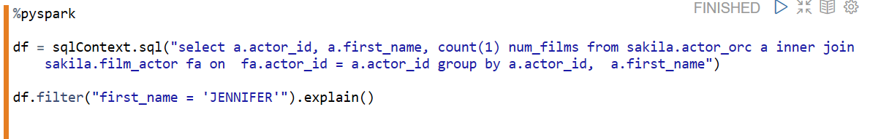
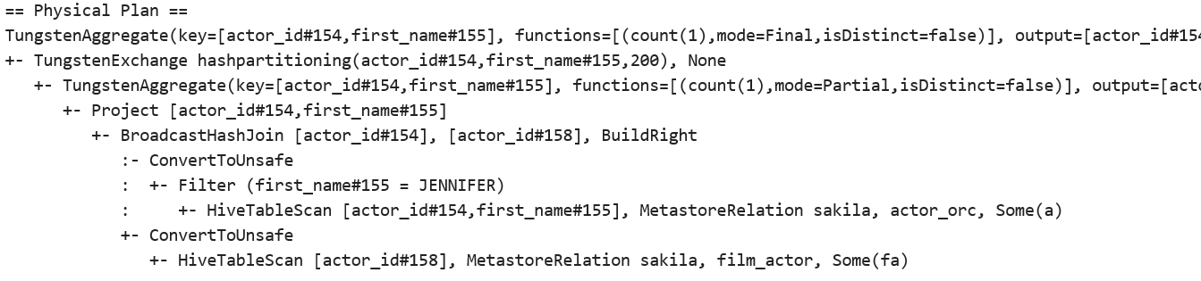
Explain plan

Slide 5
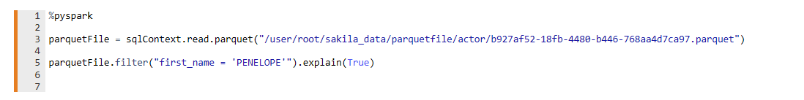
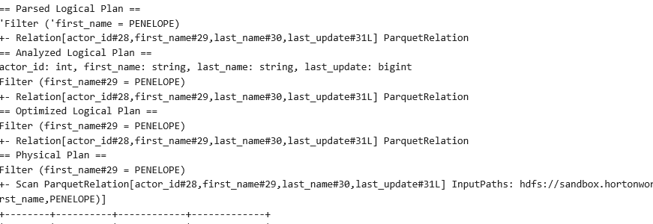
Extended Explain Plan
val plan = query.queryExecution.analyzed

Slide 6
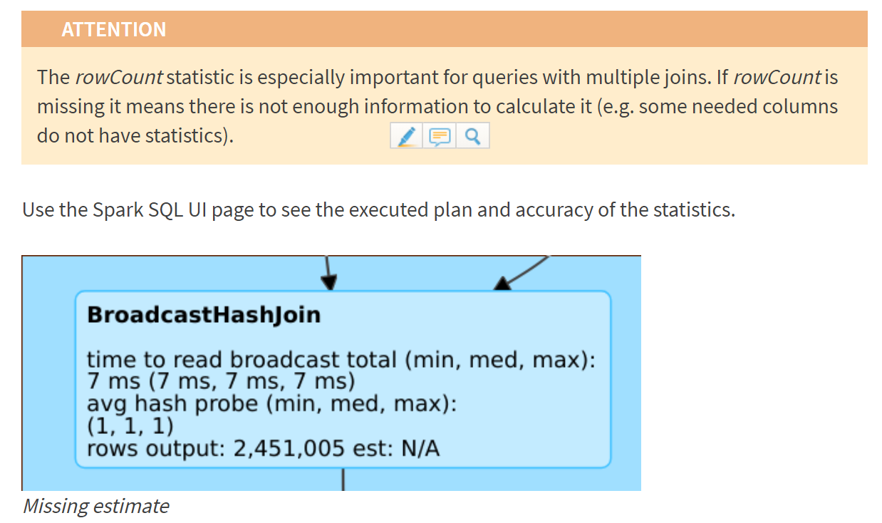
Use the Spark SQL UI page to see the executed plan and accuracy of the statistics.
TIP
RUN ANALYZE command on the tables, every time after writing to Keep the statistics Up to date

Slide 7
references
https://databricks.com/blog/2015/04/13/deep-dive-into-spark-sqls-catalyst-optimizer.html
https://docs.databricks.com/spark/latest/spark-sql/cbo.html
https://www.slideshare.net/databricks/introducing-dataframes-in-spark-for-large-scale-data-science
https://jaceklaskowski.gitbooks.io/mastering-apache-spark/spark-sql-Optimizer-ReorderJoin.html
https://dzone.com/articles/understanding-optimized-logical-plan-in-spark

